Slide 1
Human Phageprints
Gita Mahmoudabadi
Rob Phillips Lab, Caltech
Group Retreat
May, 2015

Slide 2
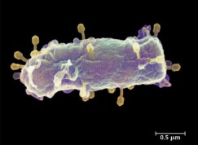
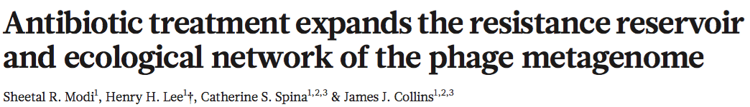
Viruses of bacteria
Most abundant biological entities on our planet
Not much known about their functional roles in microbiomes
No universal genes (16S analogue), no phylogeny, unidentified hosts

Slide 3
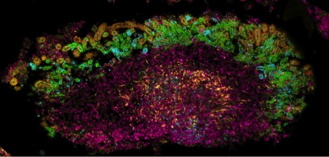
A different approach
In absence of universal sequences, could we find ubiquitous phage sequences?
How to find markers?
A survey of environmental genomes: “metagenomes”
In which microbial habitat ?
Rich in microbial diversity
Accessibility
Medical relevance
Availability of
metagenomes
Systems-level analysis of microbial community organization through combinatorial labeling and spectral imaging
Alex Valm et al, 2012

Slide 4
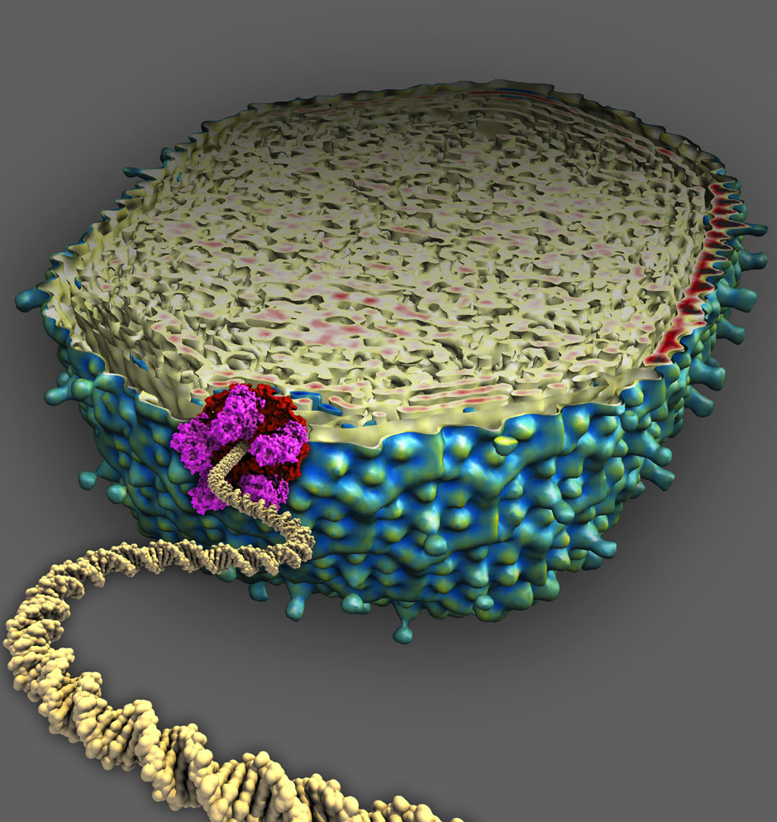
In search of ubiquitous phage sequences
NCBI Viral Ref Library ~100,000 Viral Sequences
BLAST
Mira
~9,000 Viral Contigs
Terminase Large Subunit
~ 100 TerL Contigs
BLAST
Xie
7
Notes:
This process is analogous to the conversations we’ve had about blasting different databases against each other in order to find common elements within “blastproof” sequences.
7 phage TerL families that are non-homologous were selected but as you’ll see we will have focused on a few of the most abundant markers.

Slide 5
Experimental pipeline
Sampling
DNA extraction from biofilms
PCR using barcoded primers
Next gen sequencing

Slide 6
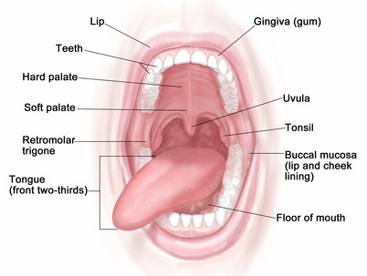
Samples
6 Oral microbial niches
Sub- and supra-gingiva
Buccal mucosa
Tongue dorsum and ventral
Hard palate
Bik et al.

Slide 7
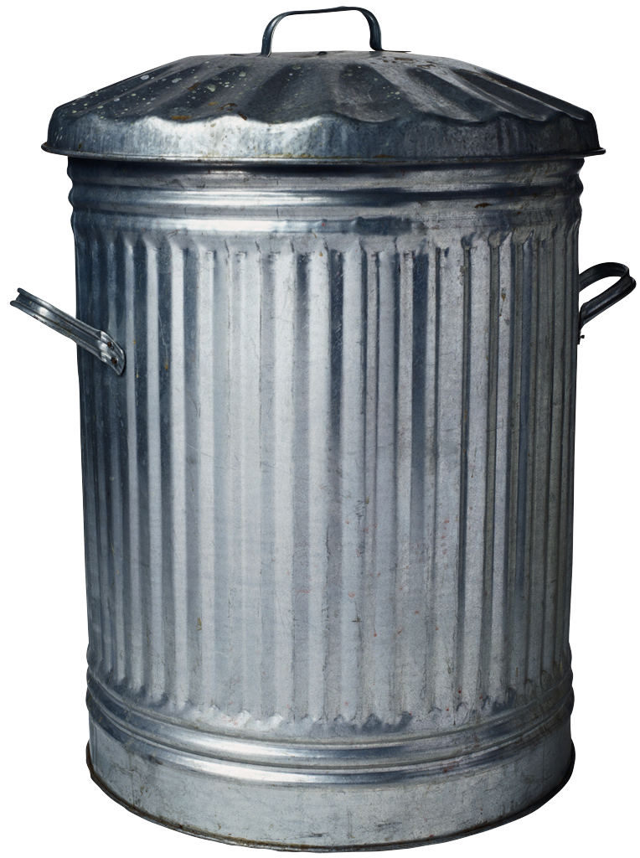
Bioinformatic pipeline
25M paired reads
300x2 paired-end MiSeq run
Joining paired reads
Eliminating pairs with 1 or more mismatches in the region of overlap
Filter joined reads with bases with error rate > 0.001
Binning joined reads based on primer sequences
Filtering sequences with errors in barcode sequence, or incorrect length
Clustering reads based on sequence similarity
Plotting relative abundance of each cluster (OTU) for each sample
Eliminating noise-induced OTUs
Demultiplexing: decoding barcodes
Rarefaction:
4000 reads per sample
OTU 1
OTU 2
OTU n
Sample x
Abundance
OTUs (1:n)
Error rate > 0.001
Phage population structure
Notes:
To sequence our pcr products, we use miseq runs because they allow the longest reads available through illumina.
This enables us to read every marker sequence twice.
When we join the reads, we’re able to detect any mismatches across the paired reads and eliminate the pair
So this gets rid of the majority of base call errors in sequencing
We then apply several other filters, eliminating sequences with low-quality bases, or sequences that have the wrong barcode length, or incorrect barcode sequence
we then randomly pick x number of sequences per sample, and this is called rarefaction. It’s to avoid coverage bias. And we’ve done a study to deterimine the min number of sequences that are required to capture the total diversity of sequences in a sample
We cluster sequences based on sequence similarity
clusters are called OTUs, or operational taxonomic units, and in microbiology they are synonymous with bacterial species.
We then apply another filter to get rid of noise-induced OTUs. And I’ll get to that in a few slides
And finally, the output of interest are traces of cluster abundances in samples. These abundance traces would then be a measure of phage population composition with a particular environment

Slide 8
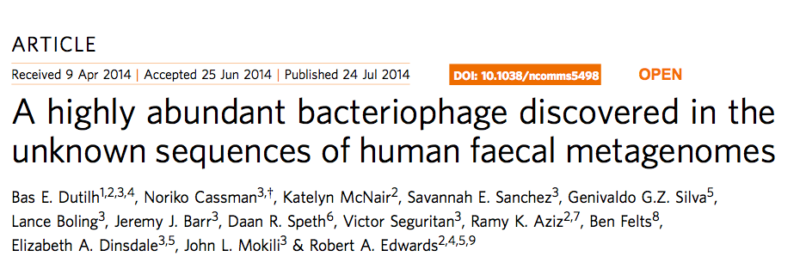
Ubiquitous phage markers confirmed
Subject IDs
Tongue
Dorsum
Hard Palate
Buccal Mucosa
Tongue Ventral
Supra- gingiva
Sub- gingiva
All sites
HB1
PCA2
12
HA
16
PCA1
25
Sample was not available
6
24
Markers based on 7 individuals
Presence of a core phageome
3
10
17
22
Notes:
First I want to show a binary depiction of results … just to show presence / absence of markers in samples
Then I’ll delve deeper into sequence data.
The markers are color coded here. So for instance, in subject 12’s tongue dorsum all markers are present. The unfilled circles are those sites that didn’t have a particular marker present.

Slide 9
A time study
Relative Abundance
0th hour
24th hour
OTUs (1:n)
Abundant
OTUs
Rare OTUs
Sibling 1
Rare OTUs
Abundant
OTUs
Sibling 2
Rare OTUs
Notes:
Let’s dive into sequence data with a fun example.
Here we did a study where my sister and I took a sample from the top surface of our tongue, right after brushing, and 24 hours later.
And during this study we were living together and eating more or less the same things.
This is the population composition of phage HB1 in my mouth. It’s entirely dominated by one OTU.
Here’s the zoomed in version of the top trace showing OTUs that are present as less than 1% of the total population.
So that’s my data, and here’s my sister’s. There are several things in common.
First, again the population in this sample is dominated by one OTU. And the second thing is that over 24 hours the traces are nearly identical.
Sibling 1 (top graphs), Sibling 2 (bottom graphs). Marker 5 (HA): 423 OTUs at 97% sequences similarity threshold, two time points (t=0, t=24 hr) from tongue dorsum.
Pink: t=24 hour, Aqua: t=0 (right after brushing teeth and tongue dorsum). Different abundance scales are shown. Pi charts represent the same data as bar charts.

Slide 10
HB1 phageprints

Slide 11
Pairwise correlations
Sample 1
Sample 2
Rel. abundance
Rel. abundance
OTUs 1:n
OTUs 1:n
Relative abundance vector
X= [ x₁ , x₂ , … , x_{n}]
Y= [ y₁ , y₂ , … , y_{n}]
Y
y_{i}
R = 0.8
Pearson correlation
Mock data
Interpreting 16S metagenomic data without clustering to achieve sub OUT resolution.
Tikhonov, et al. ISME J. 2015
x_{i}
X

Slide 12
HB1 pairwise correlation matrix
Notes:
Pearson correlation matrix of all HB1 phageprints spanning 9 subjects and four oral sites. Each phageprint is derived from the analysis of 4000 sequences associated with an individual and a particular oral site. OTUs are defined at 98% sequence similarity and OTUs with less than or equal to 0.1% relative abundance across all phageprints were filtered out (see some section in SI). The r-matrix is visualized via a heatmap that ranges from -0.02 r-value (green) to 1 (white). Phageprints are color-coded based on the individual they originate from. Oral sites shown to be positive for the HB1 marker are the tongue dorsum (TD), buccal mucosa (BM), supra-gingiva (SP), and sub-gingiva (SB). Samples whose phageprints have been replicated at least twice and averaged have an asterisk next to them (see some section in SI).

Slide 13
HA pairwise correlation matrix
Notes:
Here too, the off diagonal elem
Pearson correlation matrix of all HA phageprints encompassing 11 subjects and six oral sites. Each phageprint is derived from the analysis of 4000 sequences associated with an individual and a particular oral site. OTUs are defined at 95% sequence similarity and OTUs with less than or equal to 0.1% relative abundance across all phageprints were filtered out (see some section in SI). The r-matrix is visualized via a heatmap that ranges from -0.02 r-value (green) to 1 (white). Phageprints are color-coded based on the individual they originate from. Oral sites shown are the tongue dorsum (TD), buccal mucosa (BM), supra-gingiva (SP), sub-gingiva (SB), hard palate (HP), and ventral surface of the tongue (TV). Samples whose phageprints have been replicated at least twice and averaged have an asterisk next to them (see some section in SI).

Slide 14
Phage biogeography and community composition
A: Fraction of subjects harboring a connection
B : Connection correlation, averaged across individuals
Edge weight = A x B
Notes:
Phage biogeography patterns in the human mouth. Six different oral sites were tested for presence of phage markers HA, HB1, and PCA2. Each hexagon summarizes the community structure of a particular phage family across different oral sites within a given individual. Each vertex of a hexagon symbolizes an oral site, and the presence of a marker is signified by a filled-in vertex. The marker is considered present at an oral site if at least 4000 high-quality sequences (see Rarefaction, see QC) belonging to a terminase family are found at that oral site. The unfilled vertices are those samples that did not harbor phage markers. The missing vertices, correspond to samples that were unavailable and consequently were not tested for presence/absence of phage makers. The edges connecting different vertices represent the similarity of the phage community at one oral site to another. The thicker the edge, the more similar are the phageprints of the two connected oral sites. Here, the measure of similarity is the Pearson correlation value obtained by the pair-wise comparison of phageprints from different oral sites.

Slide 15
Things to think about
Why is there a “winner takes all”?
Competition during an exponential growth phase?
How come different dominant OTUs arise?
Genetic drift?

Slide 16
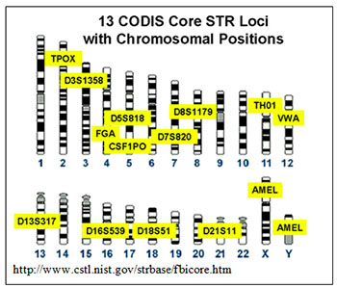
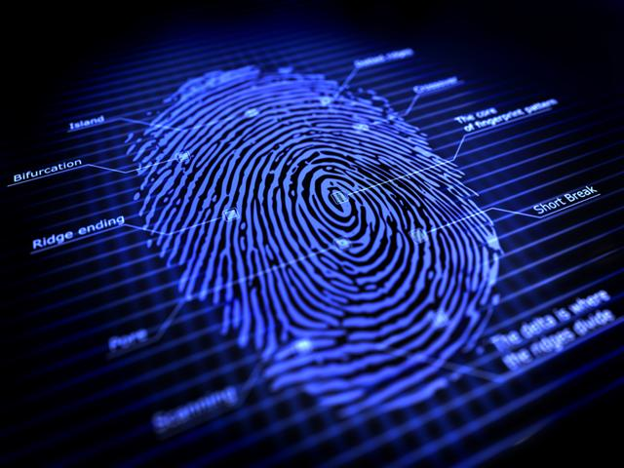
How many possible phageprints could exist?
For HB1 marker there are ~80 OTUs after noise filtering
Top 50% OTUs, ~10²³ possible patterns
More markers, orders of magnitude more combinations
~10¹⁸ possibilities from combination of 13 markers (Short Tandem Repeats - STRs)
Notes:
My point however isn’t to suggest using phage sequences for identification (though it may be a fun idea for distinguishing identical twins), rather it’s to express my astonishment at the vastness of the sequence space explored by terminases and their unique, reproducible, patterns of abundances across space and time.

Slide 17
With many thanks to:
Rob Phillips
Arbel Tadmor
Kelsey Homyk
Brian Silver
Ana Mahmoudabadi
James Boedicker
Franz Weinert
Griffin Chure
Dan Chure
Tal Einav
Stephanie Barnes
Nathan Belliveau
Everyone else in the RP lab
Geoff Lovely
The Quake Lab
Elizabeth Bik
David Relman
Morgane Grivel
San Deigo Zoo
Gwangju Institute of Technology (GIST)
You!

Slide 18
Sources and magnitude of noise
Notes:
Before I show any more data, I want to talk about noise and sources of error.
So, all these experimental processes can contribute to both noise-induced OTU formation and variation in sizes of OTUs.
To get a sense for the total level of noise our experimental protocol, we took three samples and ran through these experimental processes seperately.
We then identified OTUs that are absent in one or two of the samples.
About 30 OTUs turned out to be non-reproducible, but they are OTUs that are comprised of 1-4 sequences. So by applying an OTU size threshold, we can esily get rid of these inconsistent OTUs
Then we looked at the sd of OTU sizes across these three replicates, and amazingly, the sd are very low close to zero in fact. And only for a couple did the sd surpass 0.002
Anyway so this gives us an indication of what variations are real and which are noise.
Standard deviations of OTU relative abundances calculated for all experimental processes. Three data points per OTU are used for standard deviation calculations. These three data points correspond to measurements of OTU abundance obtained for three different samples obtained from subject 37 tongue dorsum (HB1 marker) which underwent separate sampling, DNA extraction, PCR and PCR cleanup procedures. The maximum standard deviation observed is less than 0.007 relative abundance, and majority are close to 0.
Number of non-reproducible OTUs across three samples obtained from subject 37 tongue dorsum (HB1 marker), presented as a function of OTU relative abundance. A total of 30 OTUs appear in one or two samples out of three, and therefore are considered non-reproducible. 21 out of 30 OTUs are defined by a single sequence which translates into 0.00025 relative abundance since samples are rarefied to 4000 sequences. The number of non-reproducible OTUs drops as a function of OTU relative abundance, and all OTUs with more than 4 sequences (0.001 relative abundance) are reproducible across three samples. This relative abundance threshold for noise-induced OTUs was previously obtained using a different approach, different set of samples, and a different sequencing run (see Figure 4).

Slide 19
HA phage community composition across 3 individuals
Notes:
Now I’m representing only 3 traces coming from 3 subjects. I’ve looked at many more traces, and they all are individual specific, sometimes site specific, and because of this I started calling these traces phageprints.
Now, I got tired of looking at traces, and tried to find a qunatifieable metric that allows us to do pairwise comparisons between the phageptins.
Insert pics….

Slide 20
HB1 phage-host network
Each community is dominated by 1 or 2 OTUs
Dominant OTUs are different across subjects
Node size: number of samples the OTU appears in
Edge weight: relative abundance of OTU in sample
Notes:
Here’s another way of presenting the data. This is a network of phage-host interactions. In this case the host is a human (rather than a bacterium).
The salient features of this network and the HA network which I won’t show in the interest of time, is that there are only one or two dominant OTUs in each person’s mouth
Moreover, from this degree distribution, we can tell than more than 50% of OTUs are only present in one person. So this explains the unique patterns we see.
In addition, only a few OTUs are present in all individuals, and it’s from this pool that the dominant OTUs arise.
So I am now thinking about what the implications of this particular network structure is…
HB1 phage-host network and degree distribution. A) Two types of nodes exist: OTU nodes (purple), and subject nodes. Subject nodes and edges are color-coded based on the individual they represent. Each directed edge connects an individual to a phage OTU that he/she harbors, and the edge weight is proportional to the relative abundance of the OTU in that individual’s oral community. OTU node sizes and labels are proportional to the number of individuals the OTU is present in. For OTU nodes, the node ID is the OTU ID, which can be matched to IDs in SI Tables 2 and 3 for obtaining taxonomic information regarding each OTU’s representative sequence. See SI Figure 12 to see a similar network that shows OTUs present at different oral sites. B) The degree distribution of HB1 phage-host network. This distribution was obtained by making a histogram of OTU in-degree, or the number of individuals that OTU is present in.

Slide 21


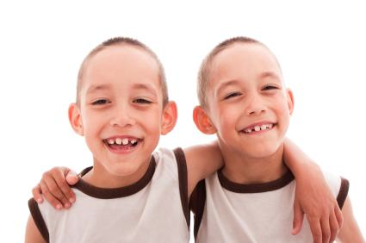
New additions to our repository
Human oral samples over a day, months, and possibly a decade!
A collection of samples from various mammals from San Diego Zoo
10 Sibling pairs including identical twins!

Slide 22
Oral Metagenomes
Mira et al. (2011)
8 metagenomes of 6 individuals with varying degrees of oral hygiene (plaque & cavity)
Xie et al. (2010)
1 metagenome of plaque from healthy individual
HMP: human microbiome project
415 oral metagenomes of 90 individuals parsed by 9 oral sites
HOMD - human oral microbiome database
574 genomes of oral bacteria

Slide 23
EXTRAS

Slide 24
HA phageprints at various microenvironments
Notes:
. HA phageprints across different oral sites and subjects. A) Subject 16 HA phageprints captured from the tongue dorsum surface, hard palate, buccal mucosa, and tongue ventral surfaces. B) Subject 16, 39 and 12 HA phageprints obtained from the tongue dorsum. Each phageprint is composed of x OTUs listed in the same order on the x-axis. The relative abundance of each OTU is shown on the y-axis. In panel A, the second and third display the phageprint in the first column at two different zooms, displaying rare OTU abundance patterns. In panel B too, the second column displays rare OTUs comprising less than 10% of total population.

Slide 25
HB1 host range

Slide 26
Marker host range

Slide 32
Phage biogeography and community composition
Notes:
Phage biogeography patterns in the human mouth. Six different oral sites were tested for presence of phage markers HA, HB1, and PCA2. Each hexagon summarizes the community structure of a particular phage family across different oral sites within a given individual. Each vertex of a hexagon symbolizes an oral site, and the presence of a marker is signified by a filled-in vertex. The marker is considered present at an oral site if at least 4000 high-quality sequences (see Rarefaction, see QC) belonging to a terminase family are found at that oral site. The unfilled vertices are those samples that did not harbor phage markers. The missing vertices, correspond to samples that were unavailable and consequently were not tested for presence/absence of phage makers. The edges connecting different vertices represent the similarity of the phage community at one oral site to another. The thicker the edge, the more similar are the phageprints of the two connected oral sites. Here, the measure of similarity is the Pearson correlation value obtained by the pair-wise comparison of phageprints from different oral sites.

